Slide 1


BAN6440: Applied Machine Learning
Assignment Six
Title: Otomoto Marketing Segmentation Model Optimization
Name: Mubanga Nsofu
Learner ID: 149050
Date: 18th December 2024
Lecturer: Professor Bucciarelli

Slide 2
Introduction
Overview
Optimise existing ANN to ensure churn prediction for customer segmentation
Compared Metrics from Baseline ANN model with Optimised Model. The latter shows better performance
Draw conclusions based on the results
Evaluate strength and Weaknesses of existing ANN and Optimise it further
Objective
Methodology
Results
Conclusions
The aim was to enhance Otomoto’s marketing segmentation by developing and optimising an Artificial Neural Network (ANN) for predicting customer churn.
To achieve this, the weakness and strengths of the existing model were analyzed.

Slide 3
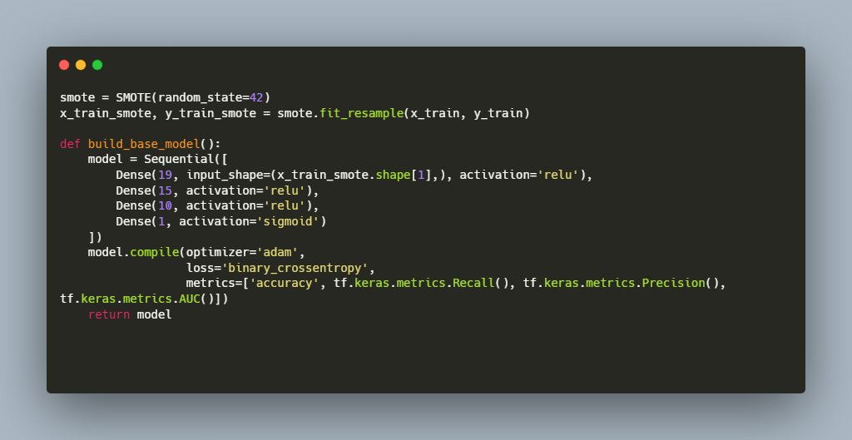
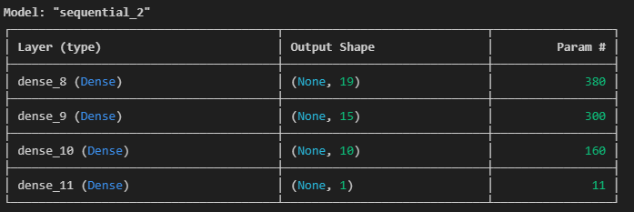
ANN Baseline Model Analysis
S
W
Strenghts
Weaknesses
Simple Architecture with only 3 hidden layers
2. Implements SMOTE to help class imbalance in the dataset
3. Uses standard metrics including Accuracy, Precision, Recall and AUC-ROC
4. Flexible and Adaptable as it serves as a baseline model for exprimentation and comparison
No Regularization implemented, prone to overfitting especially for imbalanced datasets
No feature scaling which can impact optimisation process especially for neural networks
Fixed output bias the output layer does not account for class imbalance which can lead to poor convergence
SMOTE may introduce noisy or less realistic synthetic examples
No hyperparameter tuning learning rate and layer configurations are fixed and not optimised
The model architecture is shown above with four dense layers and only 871 trainable parameters

Slide 4
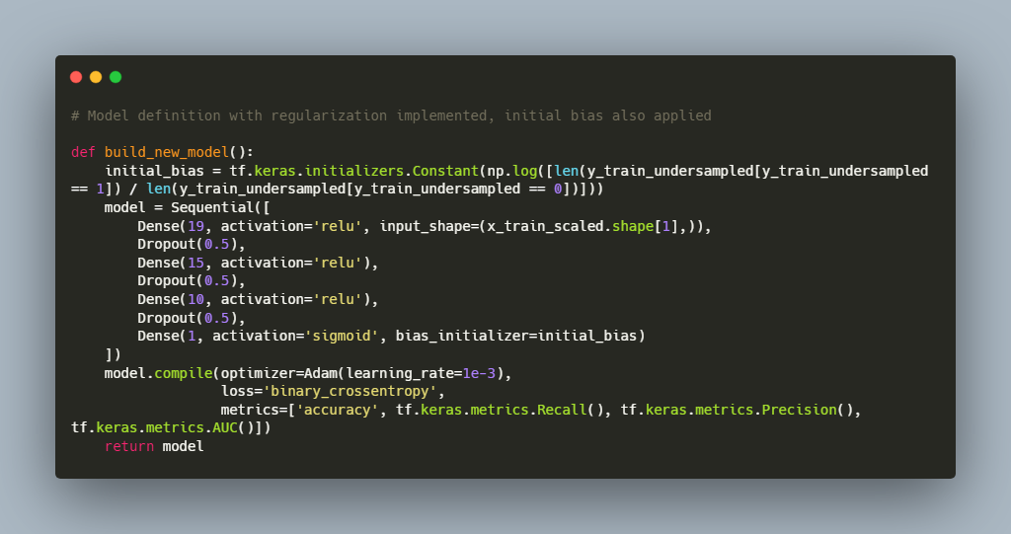
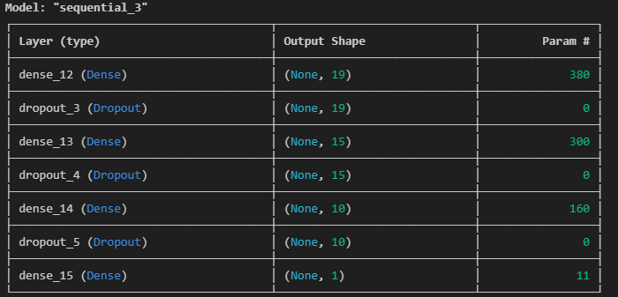
ANN Model Improvement
Key ANN Optimisations
Replaced SMOTE with under-sampling to avoid introducing synthetic noise in the dataset and reduce the risk of overfitting (Tamanna,2023) & (Tang, 2023).
Applied feature scaling improves convergence and optimisation (Google,2024).
Bias initialisation in the output layer to reflect the imbalance (Google,2024).
Drop out regularization was introduced after each dense layer to reduce overfitting
In addition to the above optimisations, early stopping was implemented to stop training once validation loss stopped improving. In addition, a lower learning rate for the Adam optimizer was used (Google,2024).
The model architecture is shown above with four dense layers, but now includes regularisation

Slide 5
Summary Performance Evaluation
Metric | Baseline ANN | Optimized ANN
Accuracy | 61.43% | 64.16%
Precision | 39.75% | 42.0%
Recall | 87.58% | 91.22%
F1-Score | 54.68% | 57.49%
AUC-ROC | 75.75% | 80.60%
The Optimised ANN model consistently outperforms the base line ANN model across the different metrics
Detailed results are discussed in the next slide

Slide 6
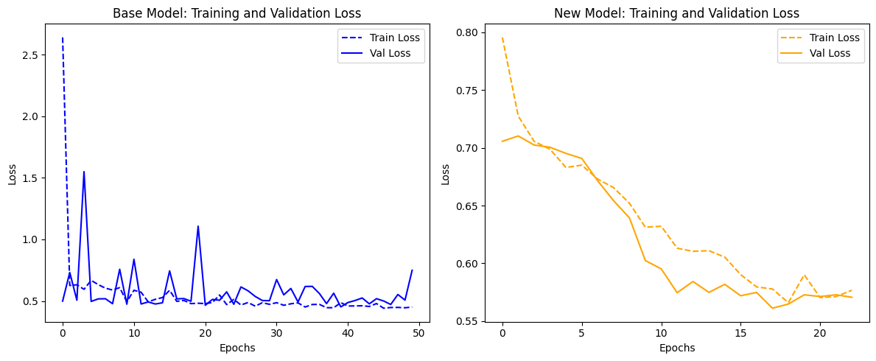
Training loss evaluation
The loss curves indicate that the base model demonstrates unstable training, as the loss fluctuates throughout the process. Additionally, the model exhibits poor generalisation, with the validation loss consistently remaining high. The absence of certain optimization processes in the model is contributing to these issues.
The New Model post the optimisation show better behaved curves with improved validation loss performance and smoother training curves.

Slide 7
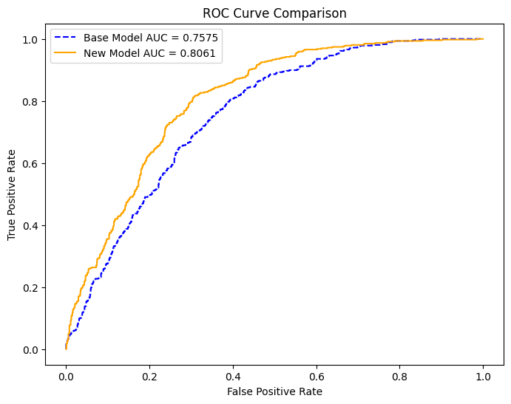
ROC Curves
The New Model has better overall discriminatory power between the two classes in the churn column
The New Model's higher AUC and steeper initial climb means it is better at achieving a high true positive rate (recall) with a low false positive rate. This aligns well to minimise customer churn.
The base model eventually tries to catch up on the true positive rate, though the new model still maintains the edge.

Slide 8
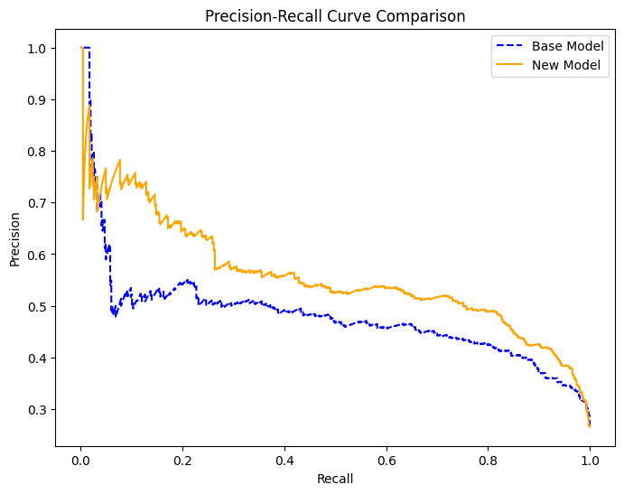
Precision-Recall Curves
The New Model (orange curve) consistently outperforms the Base Model (blue curve) across almost the entire range of recall values.
This means that for any given level of recall (proportion of actual churners identified), the New Model achieves higher precision (accuracy of churn predictions).
This means the new ANN model has a superior ability to identify churners
Consequently, the new model is more suitable for Otomoto Marketing Segmentation, where minimising customer churn impact is paramount.

Slide 9
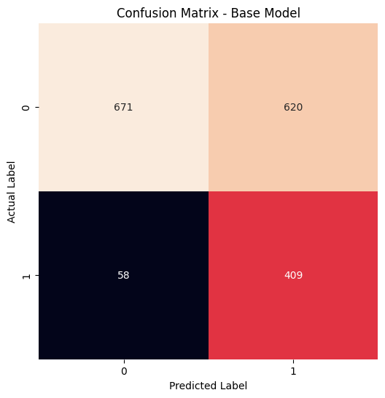
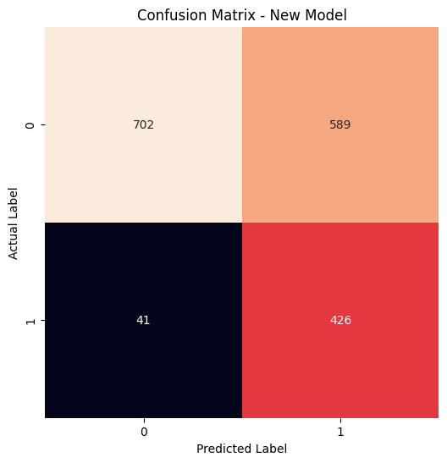
Confusion Matrix [1/3]
Base Model:
True Positives (TP): 409 Correctly predicted churn
True Negatives (TN): 671 Correctly predicted non-churn
False Positives (FP): 620 Incorrectly predicted churn (when there is no churn)
False Negatives (FN): 58 Incorrectly predicted no churn (when there was churn)
New Model:
True Positives (TP): 426 Correctly predicted churn
True Negatives (TN): 702 Correctly predicted non-churn
False Positives (FP): 589 Incorrectly predicted churn (when there is no churn)
False Negatives (FN): 41 Incorrectly predicted no churn (when there was churn)
Cost of False Negatives: A false negative in churn prediction means Otomoto fails to identify a customer at risk of leaving, leading to lost revenue. The new model has fewer false negatives, with 41 compared to 58 in the base model.

Slide 10
Confusion Matrix [2/3]
Cost of False Positives: A false positive occurs when Otomoto wrongly predicts customer churn. This can waste resources but is less costly than losing a customer. The new model has 589 false positives, down from 620 in the base model. This means the new ANN model has a superior ability to identify churners
The New Model shows improvement across all metrics:
A higher recall for the new model allows it to capture a larger proportion of actual churners
Recall = TP/(TP+FN) , 426/(426+41) =0.912(New Model) compared to 409/(409+58) = 0.875 (base model)
A higher Precision allows the new model to have a better rate of correct churn predictions among all the positive cases
Precision = TP/(TP+FP), 426/(426+589) = 0.420(New Model) compared to 409/(409+620) = 0.397 (base model)

Slide 11
Confusion Matrix [3/3]
A higher specificity for the new model allows it to capture the proportion of actual negatives that were correctly identified
Specificity = TN/(TN+FP) , 702/(702+589) =0.544(New Model) compared to 671/(671+620) = 0.520 (base model)
The F1-Score balances Precision and Recall as these are two competing objectives. The New model shows better F1-Scores.
F1-Score = 2*(Precision*Recall)/(Precision+Recall)= 0.571(New Model) compared to 0.544 (base model)
The new model has a higher F1-Score meaning it is doing a better job at both identifying churners and being accurate in predictions.
Based on all the analyzed metrics, the new model is better suited to Otomoto Market Segmentation use case

Slide 12
Outcomes and Areas of Improvement
Outcomes:
The new model showed improved generalisation. The addition of dropout and early stopping made the model perform better on unseen data
Bias initialisation helped to stabilise the initial predictions, preventing instability during early epochs
Undersampling helped to handle class imbalance better. It avoided the risk of synthetic noise that gets introduced by SMOTE
Efficient optimisation due to feature scaling and lower learning rates
The new model is more suitable for the Otomoto Marketing Segmentation Use case than the baseline model
Areas of Improvement:
In the next iterations, the following areas could be considered to improve the performance of the new model further
Feature Engineering:
Retain most relevant features using SHAP or RFE GunKurnia, (2024).
Derive new features or interaction terms
An Ensemble approach to improve overall performance
Transfer learning using pre-trained models on the churn dataset
Automated optimisation of hyperparameters and Neural Architecture Search from AutoKeras (Jin and Hu, 2019)
Notes:
GunKurnia, (2024).

Slide 13
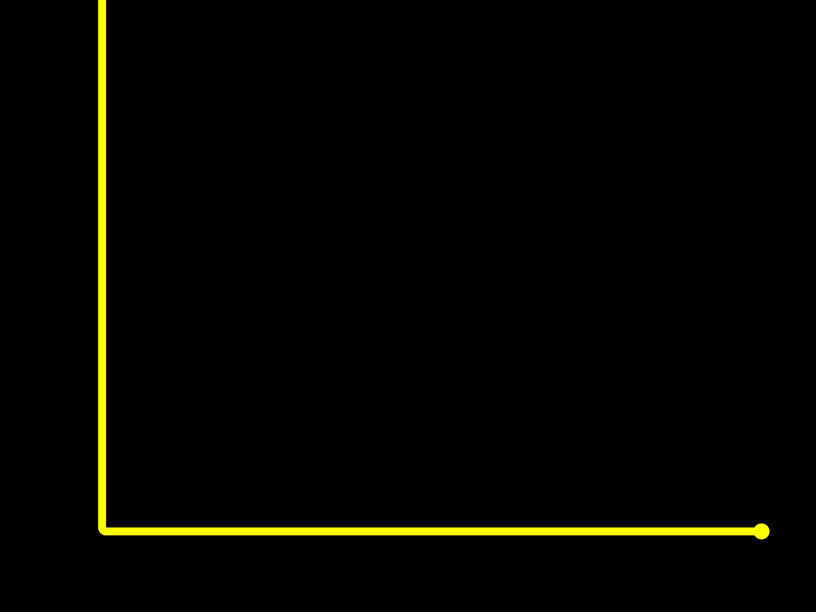

References
Google. (2024). Classification on imbalanced data. TensorFlow Core. https://www.tensorflow.org/tutorials/structured_data/imbalanced_data
Tamanna. (2023). Handling Imbalanced Datasets in Python: Methods and Procedures. Medium. https://medium.com/@tam.tamanna18/handling-imbalanced-datasets-in-python-methods-and-procedures-7376f99794de</p
Tang, T. (2023). Class Imbalance Strategies — A Visual Guide with Code. Towards Data Science. https://towardsdatascience.com/class-imbalance-strategies-a-visual-guide-with-code-8bc8fae71e1a
Jin, H., Song, Q., & Hu, X. (2019). Auto-Keras: An Efficient Neural Architecture Search System. Proceedings of the 25th ACM SIGKDD International Conference on Knowledge Discovery & Data Mining, 1946–1956. https://doi.org/10.1145/3292500.3330648
GunKurnia. (2024). Selecting Independent Features: Balancing Feature Selection, SHAP Values, and Domain Knowledge for Better Model Accuracy. Medium. https://medium.com/@gunkurnia/selecting-independent-features-balancing-feature-selection-shap-values-and-domain-knowledge-for-d3231a332a9c

Slide 14
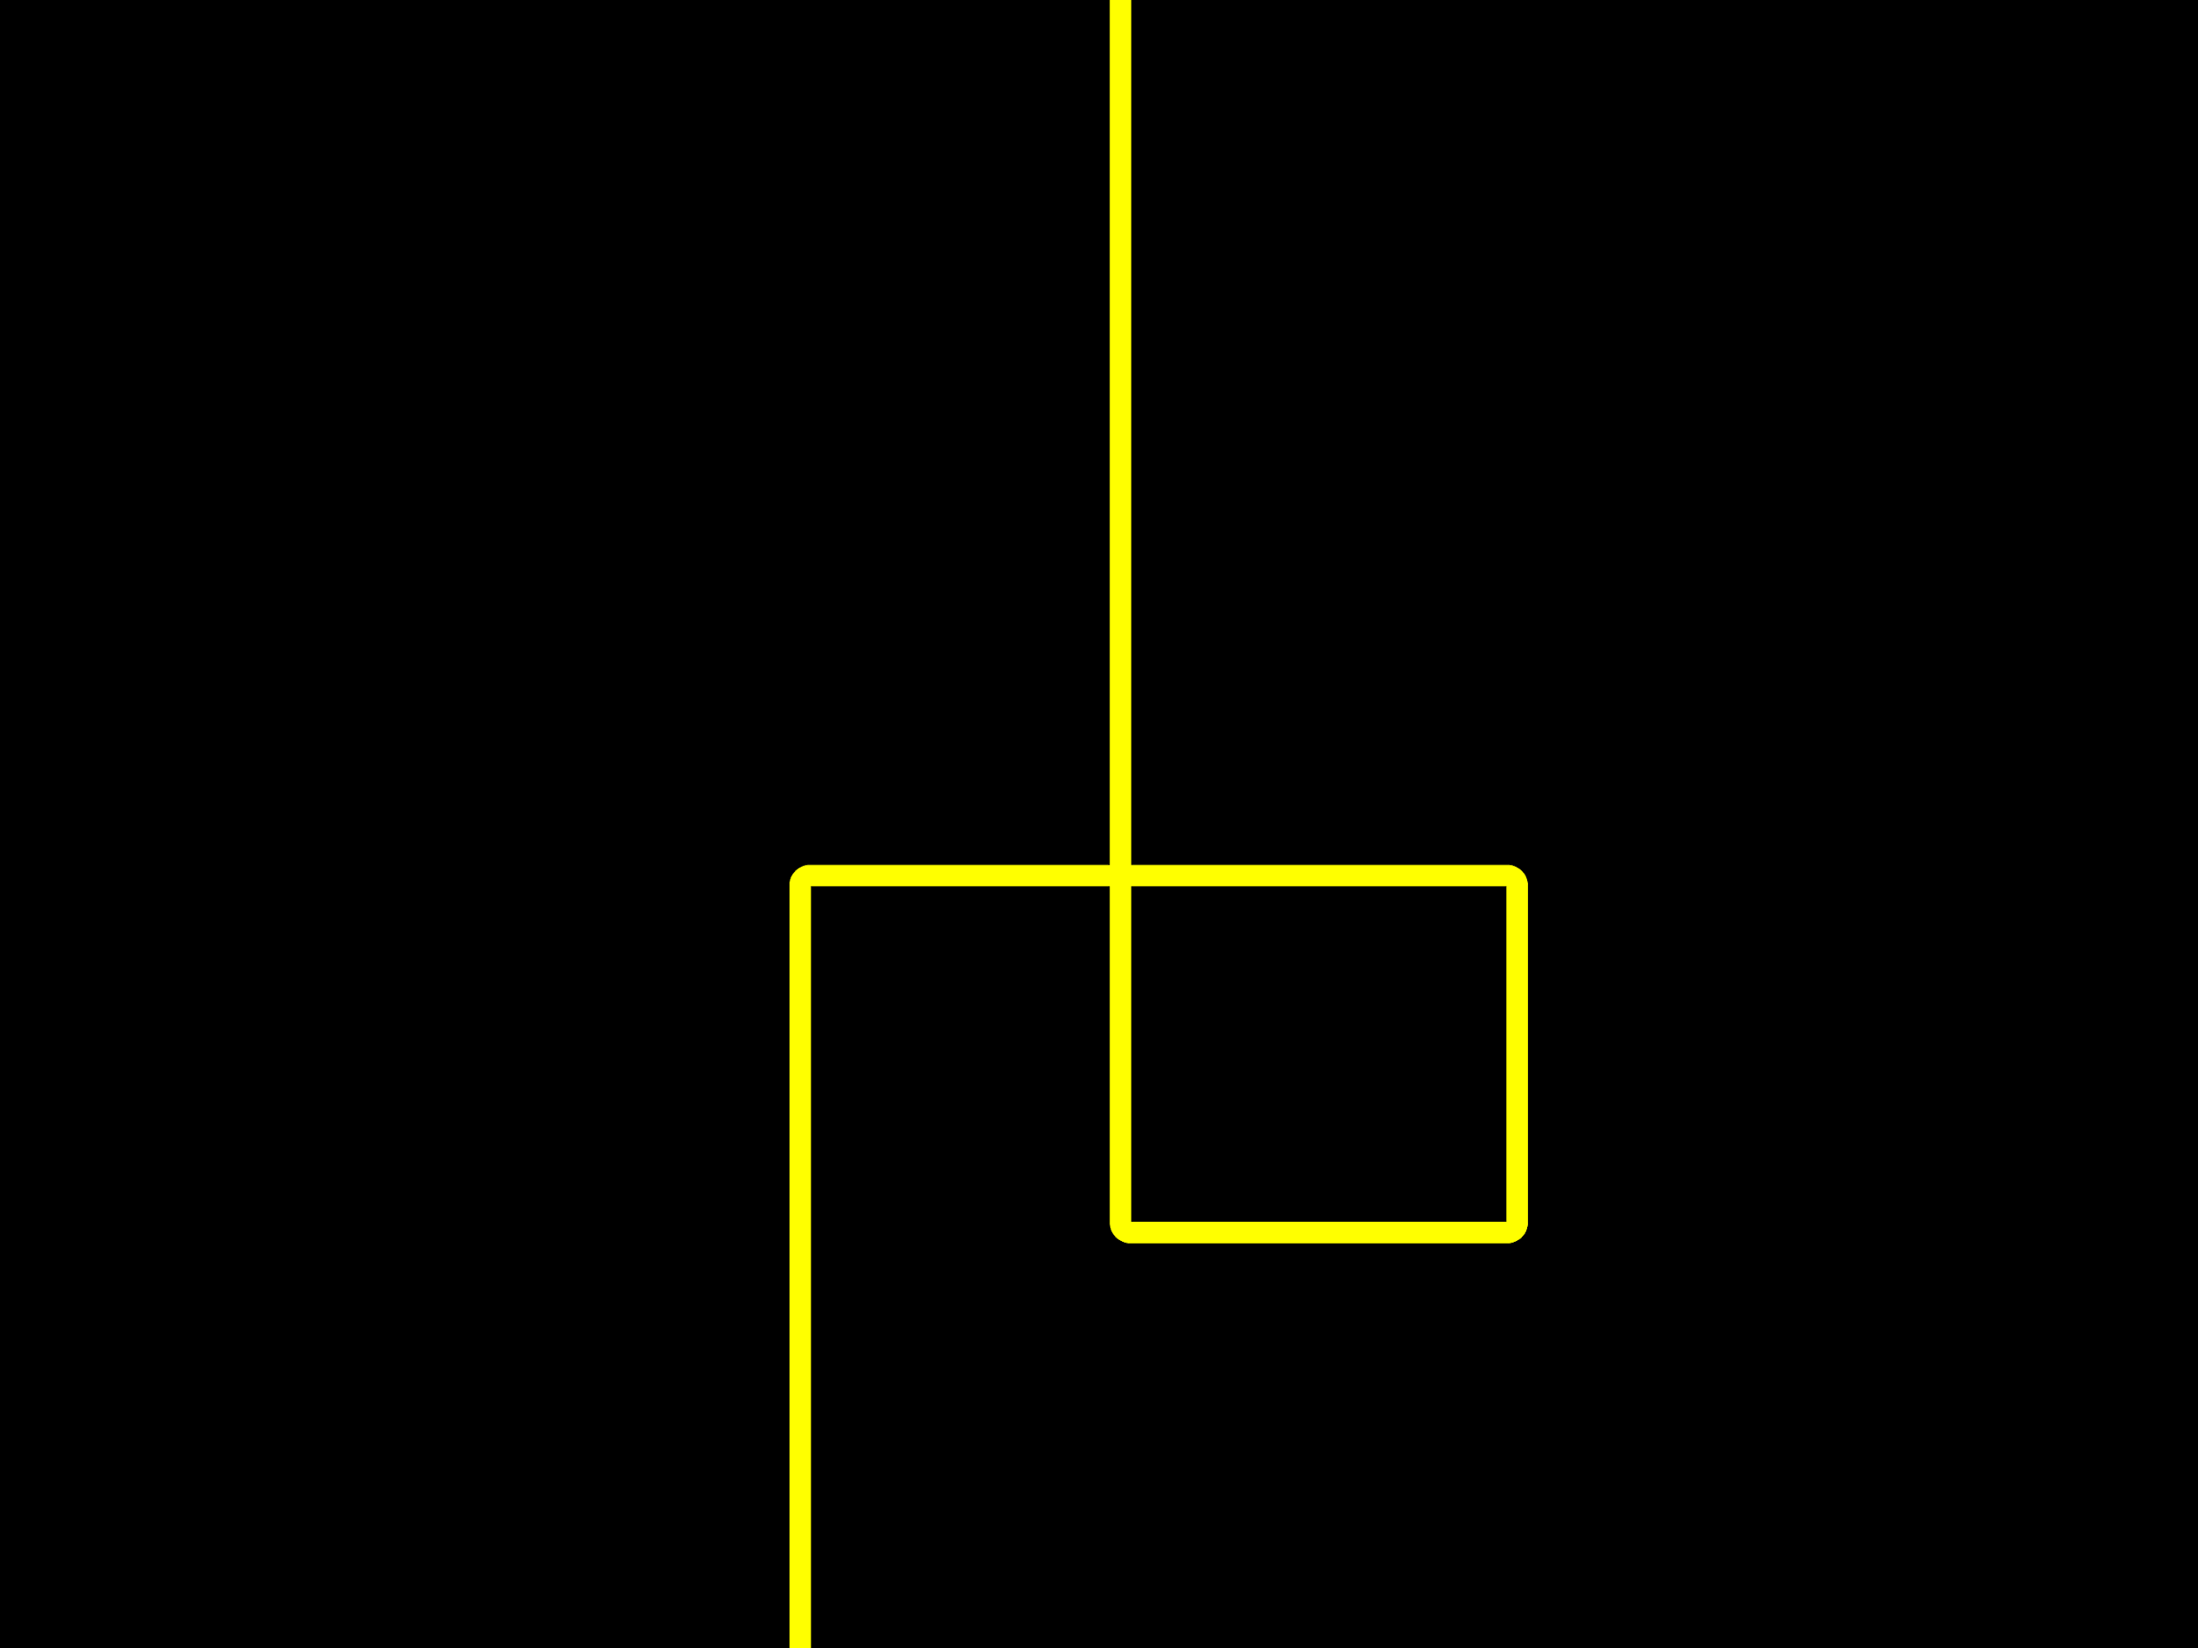
Thank you!

